Slide 1
Chapter 4: Processor Architecture
Topics:
Y86 Instruction Set Architecture
Pipelining to improve performance
Data Hazards
Branch Misprediction

Slide 2
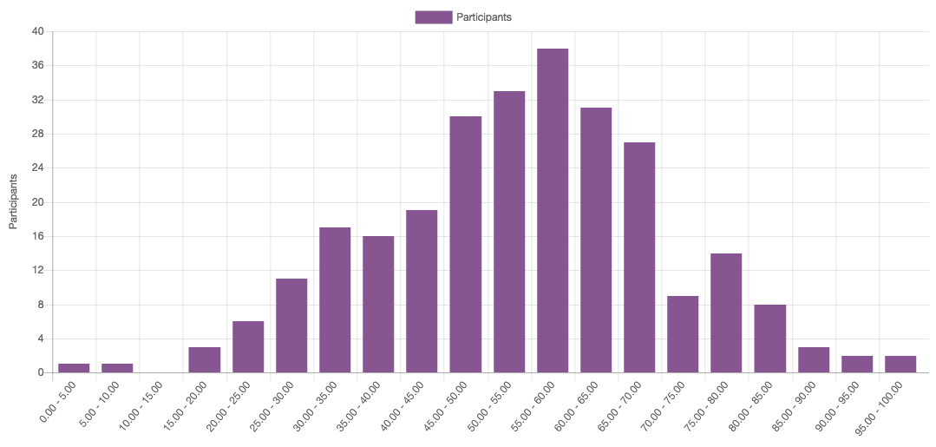
Announcements
Midterm #2 results
Average = 54
Final grades incorporate course difficulty but exams not curved
Solutions released after late test takers finish exam this week
If you need a regrade, drop by Prof. Han’s office hours

Slide 3
Announcements
Attack Lab #3 due Monday Oct 30 at 9 am
Sign up for grading time slots later this week
Next recitation exercise released later this week
Read:
Chapter 4.1, 4.3.1-4.3.2, “Surveying SEQ” in 4.3.3, 4.4, 4.5.1-4.5.6
Do Practice problems
Upcoming schedule:
Mon Nov 13 Lab #4 due (released next week)
Wed Nov 15 Midterm #3

Slide 4
Major Revelations So Far…
Two’s complement encoding and arithmetic for integers
Programs in high-level languages are compiled into assembly instructions and executed on the CPU
Assembly uses a call stack to efficiently manage function calls
Call stacks can be overflowed on x86 CPUs, resulting in execution of malicious code
Floating point representation encodes real #s as M*2E, and x86 has separate FP registers & instructions
Next up: How to improve performance using 1) pipelining, 2) parallelism, and 3) caching

Slide 5
Binary Object Code
00401040 <_sum>:
0: 55 push %ebp
1: 89 e5 mov %esp,%ebp
3: 8b 45 0c mov 0xc(%ebp),%eax
6: 03 45 08 add 0x8(%ebp),%eax
9: 89 ec mov %ebp,%esp
b: 5d pop %ebp
c: c3 ret
d: 8d 76 00 lea 0x0(%esi),%esi
Encoding & Execution
How is it that “55” represents “push %ebp”
How is it that “03 45 08” represents “add 0x8(%ebp), %eax”?
Note how the encodings are variable length
How does the CPU execute each instruction?
Notes:
Disassembled object code

Slide 6
Y86 Processor State
Program registers
Condition codes
Memory
%rax
%rsp
%r8
%r12
%rcx
%rbp
%r9
%r13
OF
ZF
SF
%rdx
%rsi
%r10
%r14
PC
%rbx
%rdi
%r11
Program Registers
15 similar to x86-64. Each 64 bits
Condition Codes
Single-bit flags set by arithmetic or logical instructions
OF: Overflow ZF: Zero SF:Negative
Program Counter
Indicates address of instruction
Memory
Byte-addressable storage array
Words stored in little-endian byte order

Slide 7
Y86 Instructions
Format
1--10 bytes of information read from memory
Can determine instruction length from first byte
Not as many instruction types, and simpler encoding than with x86-64
Each accesses and modifies some part(s) of the program state

Slide 8
Encoding Registers
Each register has 4-bit ID
Same encoding as in x86-64
Register ID 15 indicates “no register”
Will use this in our hardware design in multiple places
%rax
0
%rsp
4
%r8
8
%r12
C
%rcx
1
%rbp
5
%r9
9
%r13
D
%rdx
2
%rsi
6
%r10
A
%r14
E
%rbx
3
%rdi
7
%r11
B
F

Slide 9
Instruction Example
Addition Instruction
Add value in register rA to that in register rB
Store result in register rB
Note that Y86 only allows addition to be applied to register data
Two-byte encoding
First indicates instruction type
Second gives source and destination registers
e.g., addq %rax,%rsi Encoding: 60 06
Set condition codes based on result
Generic Form
Encoded Representation
addq rA, rB
6
0
rA
rB

Slide 10
Arithmetic and Logical Operations
Instruction Code
Function Code
Add
Refer to generically as “OPq”
Encodings differ only by “function code”
Low-order 4 bits in first instruction word
Operate only on register data, not memory
Unlike x86-64, where one of operands could be a memory location
Separate move instructions to operate on memory
Set condition codes as side effect
addq rA, rB
6
0
rA
rB
Subtract (rA from rB)
subq rA, rB
6
1
rA
rB
And
andq rA, rB
6
2
rA
rB
Exclusive-Or
xorq rA, rB
6
3
rA
rB

Slide 11
Move Operations
rrmovq rA, rB
2
0
rA
rB
Register --> Register
Immediate --> Register
irmovq V, rB
3
0
f
rB
V
Register --> Memory
rmmovq rA, D(rB)
4
0
rA
rB
D
Memory --> Register
mrmovq D(rB), rA
5
0
rA
rB
D
Like the x86 movq instruction
Simpler format for memory addresses
Give different names to keep them distinct
Supports only simple addressing mode: D(rX)
Notes:
Note in mrmovq how the order of rA and rB are reversed in the encoding.

Slide 12
Jump Instructions
Jump Unconditionally
jmp Dest
7
0
Dest
Refer to generically as “jXX”
Encodings differ only by “function code”
Based on values of condition codes
Same as x86-64 counterparts
Encode full destination address
Unlike PC-relative addressing seen in x86
Jump When Less or Equal
jle Dest
7
1
Dest
Jump When Less
jl Dest
7
2
Dest
Jump When Equal
je Dest
7
3
Dest
Jump When Not Equal
jne Dest
7
4
Dest
Jump When Greater or Equal
jge Dest
7
5
Dest
Jump When Greater
jg Dest
7
6
Dest

Slide 13
Y86 Program Stack
Stack “Bottom”
Region of memory holding program data
Used in Y86 (and x86) for supporting procedure calls
Stack top indicated by %rsp
Address of top stack element
Stack grows toward lower addresses
Top element is at highest address in the stack
When pushing, must first decrement stack pointer
When popping, increment stack pointer
•
•
•
Increasing
Addresses
%rsp
Stack “Top”

Slide 14
Stack Operations
pushq rA
a
0
rA
f
Decrement %rsp by 8
Store word from rA to memory at %rsp
Like x86-64
Read word from memory at %rsp
Save in rA
Increment %rsp by 8
Like x86-64
popq rA
b
0
rA
f

Slide 15
Subroutine Call and Return
call Dest
8
0
Dest
Push address of next instruction onto stack
Start executing instructions at Dest
Like x86-64
Pop value from stack
Use as address for next instruction
Like x86-64
ret
9
0

Slide 16
Miscellaneous Instructions
nop
1
0
Don’t do anything
Stop executing instructions
x86 has comparable instruction, but can’t execute it in user mode
We will use it to stop the simulator
halt
0
0

Slide 17
Y86 Instruction Set
Byte
0
1
2
...
...
9
halt
0
0
addq
6
0
nop
1
0
subq
6
1
rrmovq rA, rB
2
0
rA
rB
andq
6
2
irmovq V, rB
3
0
f
rB
V
xorq
6
3
rmmovq rA, D(rB)
4
0
rA
rB
D
jmp
7
0
mrmovq D(rB), rA
5
0
rA
rB
D
jle
7
1
OPl rA, rB
6
fn
rA
rB
jl
7
2
jXX Dest
7
fn
Dest
je
7
3
call Dest
8
0
Dest
jne
7
4
ret
9
0
jge
7
5
pushq rA
A
0
rA
f
jg
7
6
popq rA
B
0
rA
f

Slide 18
Writing Y86 Code
Try to Use C Compiler as Much as Possible
Write code in C and compile for x86-64 with gcc -S
Transliterate into Y86
Wrote an assembler called YAS
Coding Example
Sum count elements in a long array starting at pointer start

Slide 19
Y86 Code Generation Example
C code:
/* Sum count # of longs
starting at ptr “start” */
long sum(long *start, long count)
{
long sum = 0;
while (count) {
sum += *start;
start++;
count--;
}
return sum;
}
X86-64 code:
/* start in %rdi, count in %rsi */
sum:
movl %0, %eax // sum = 0
jmp .L2 // goto test
.L3: // loop:
addq (%rdi), %rax // add *start to sum
addq $8, %rdi // start++
subq $1, %rsi // count—
.L2: // test:
testq %rsi, %rsi // test sum
jne .L3 // if !=0, goto loop
rep; ret // return

Slide 20
Y86 Code Generation Example
X86-64 code:
Y86-64 code:
/* start in %rdi,
count in %rsi */
sum:
movl %0, %eax
jmp .L2
.L3:
addq (%rdi), %rax
addq $8, %rdi
subq $1, %rsi
.L2:
testq %rsi, %rsi
jne .L3
rep; ret
/* start in %rdi,
count in %rsi */
sum:
irmovq $8, %r8 // constant 8
irmovq $1, %r9 // constant 1
xorq %rax %rax // sum = 0
andq %rsi,%rsi // set CC
jmp test // goto test
loop : // loop:
mrmovq (%rdi), %r10 // get *start
addq %r10,%rax // add to sum
addq %r8, %rdi // start++
subq $r9, %rsi // count—, set CC
test: // test:
jne loop // stop when 0
ret // return

Slide 21
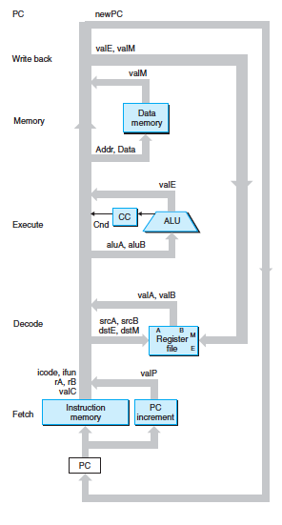
Executing CPU Instructions
Each Y86 instruction can be divided into 6 stages of execution, e.g. addq %rdx,%rcx and mrmovq 4(%rdx), %rcx
Fetch instruction
Decode Instruction
Execute Instruction
Store results to memory or retrieve values from memory
Write back results to registers
Update CPU state
Update PC
This is the SEQ architecture of the textbook

Slide 22
Instruction Decoding
Optional
Optional
6
0
rA
rB
D
icode
ifun
rA
rB
valC
Instruction Format – Different Fields
Instruction byte icode:ifun
Optional register byte rA:rB
Optional constant word valC
Notes:
add has register byte but not constant word
j* has constant word but not register byte
mrmov and rmmove have both

Slide 23
Arithmetic Logic Unit
Function code = 0
Function code = 1
Function code = 2
Function code = 3
Y
A
Y
A
Y
A
Y
A
A
L
U
A
L
U
A
L
U
A
L
U
X + Y
X - Y
X & Y
X ^ Y
X
B
OF
X
B
OF
X
B
OF
X
B
OF
ZF
ZF
ZF
ZF
CF
CF
CF
CF
Combinational logic
Continuously responding to inputs
Control signal selects function computed
Corresponding to 4 arithmetic/logical operations in Y86
Also computes values for condition codes

Slide 24
SEQ Hardware
Some lines
omitted for
brevity
Notes:
Note: not every line/connection is shown. Some are omitted for brevity.
valP is input as Data to memory stage since a call will push the return address (= valP) into memory on the stack

Slide 25
Executing An Arithmetic/Logical Operation
OPq rA, rB
6
fn
rA
rB
Fetch
Read 2 bytes
Decode
Read operand registers
Execute
Perform operation
Set condition codes
Memory
Do nothing
Write back
Update register
PC Update
Increment PC by 2

Slide 26
Stage Computation: Arith/Log. Ops
OPq rA, rB
Fetch
icode:ifun ← M₁[PC]
Read instruction byte
rA:rB ← M₁[PC+1]
Read register byte
valP ← PC+2
Compute next PC
Decode
valA ← R[rA]
Read operand A
valB ← R[rB]
Read operand B
Execute
valE ← valB OP valA
Perform ALU operation
Set CC
Set condition code register
Memory
Write
back
R[rB] ← valE
Write back result
PC update
PC ← valP
Update PC
Formulate instruction execution as sequence of simple steps
Use same general form for all instructions

Slide 27
Execution Example
5. Memory stage is
unused for Y86 addq
addq %rdx, %rcx
Encoding: 0x6021
Byte 1
icode=6
ifun=0
Byte 2
rA=%rdx=2
rB=%rcx=1
4. Result is written
back to %rcx.
%rdx+
%rcx
addq
3. ALU executes addq
instruction on inputs,
generates result
%rcx
%rdx
2. Decode values
6 0 2 1
1. Fetch instruction
= 0x6021 from
mem loc pointed to by PC

Slide 28
Executing rmmovq
rmmovq rA, D(rB)
4
0
rA
rB
D
Fetch
Read 10 bytes
Decode
Read operand registers
Execute
Compute effective address
Memory
Write to memory
Write back
Do nothing
PC Update
Increment PC by 10

Slide 29
Stage Computation: rmmovq
rmmovq rA, D(rB)
Fetch
icode:ifun ← M₁[PC]
Read instruction byte
rA:rB ← M₁[PC+1]
Read register byte
valC ← M₈[PC+2]
Read displacement D
valP ← PC+10
Compute next PC
Decode
valA ← R[rA]
Read operand A
valB ← R[rB]
Read operand B
Execute
valE ← valB + valC
Compute effective address
Memory
M₈[valE] ← valA
Write value to memory
Write
back
PC update
PC ← valP
Update PC
Use ALU for address computation

Slide 30
rmmovq Execution
5. No writeback
stage for rmmovq
Example:
rmmovq %rdx, 8(%rcx)
Encoding: 0x40210800000000000000
Byte 1
icode=4
ifun=0
Byte 2
rA=%rdx=2
rB=%rcx=1
Bytes 3-10
valC = 8 = Displacement D
D = 0x0800000000000000 (is stored in byte-reversed little Endian order )
Store
4. %rdx is written
in memory location
%rcx+8
%rcx+
8
%rdx
add
addresses
3. ALU executes rmmovq
by adding to compute
an effective address
8
%rcx
2. Decode values
4 0 2 1
0x08
1. Fetch instruction
= 0x40210800000000000000
from mem loc pointed to by PC

Slide 31
Executing popq
popq rA
b
0
rA
f
Fetch
Read 2 bytes
Decode
Read stack pointer
Execute
Increment stack pointer by 8
Memory
Read from old stack pointer
Write back
Update stack pointer
Write result to register
PC Update
Increment PC by 2
Normally you first pop into a register, then shrink the stack pointer, but here we reverse the order due to the hardware stage design
Have to remember both old and new stack pointer values
Notes:
Note how unlike the previous two examples of addq and rmmovq, popq requires both the memory stage and write-back stage to be busy in order to successfully complete the instruction.

Slide 32
Stage Computation: popq
popq rA
Fetch
icode:ifun ← M₁[PC]
Read instruction byte
rA:rB ← M₁[PC+1]
Read register byte
valP ← PC+2
Compute next PC
Decode
valA ← R[%rsp]
Read stack pointer
valB ← R [%rsp]
Read stack pointer
Execute
valE ← valB + 8
Increment stack pointer
Memory
valM ← M₈[valA]
Read from stack
Write
back
R[%rsp] ← valE
Update stack pointer
R[rA] ← valM
Write back result
PC update
PC ← valP
Update PC
Use ALU to increment stack pointer
Must update two registers
Popped value
New stack pointer

Slide 33
Executing Jumps
jXX Dest
7
fn
Dest
fall thru:
XX
XX
Not taken
target:
XX
XX
Taken
Fetch
Read 9 bytes
Increment PC by 9
Decode
Do nothing
Execute
Determine whether to take branch based on jump condition and condition codes
Memory
Do nothing
Write back
Do nothing
PC Update
Set PC to Dest if branch taken or to incremented PC if not branch

Slide 34
Stage Computation: Jumps
jXX Dest
Fetch
icode:ifun ← M₁[PC]
Read instruction byte
valC ← M₈[PC+1]
Read destination address
valP ← PC+9
Fall through address
Decode
Execute
Cnd ← Cond(CC,ifun)
Take branch?
Memory
Write
back
PC update
PC ← Cnd ? valC : valP
Update PC
Compute both addresses
Choose based on setting of condition codes and branch condition

Slide 35
Pipelining
Pipeline Example:
addq
subq
movq
cmpq
jle
Executing a single instruction at a time leaves many stages idle
What happens if we insert a bank of registers between each stage?
The result of each stage can be saved
As instruction I reaches the Writeback stage, all previous stages are busy
Memory stage occupied by instructions I+1
Execute stage occupied by instruction I+2
Decode stage occupied by instruction I+3
Fetch stage occupied by instruction I+4, .etc…

Slide 36
Pipelining
Pipeline Example:
addq
subq
movq
cmpq
jle
End result is faster rate of execution thanks to pipelining
Previous non-pipelined rate = one instruction per all six stages
New pipelined rate = one instruction per a single stage, i.e. interarrival time between instructions at output of pipeline is one stage
New pipelined rate >> previous non-pipelined rate
However, the cumulative delay of each individual instruction through the full CPU (all stages) is still approximately the same

Slide 37


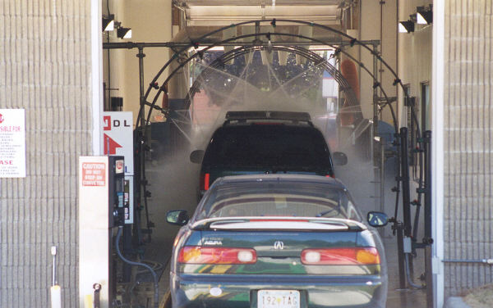
Real-World Pipelines: Car Washes
Sequential
Parallel
Pipelined
Idea
Divide process into independent stages
Move objects through stages in sequence
At any given time, multiple objects being processed

Slide 38

Computational Example
300 ps
20 ps
Combinational
logic
R
e
g
Delay = 320 ps
Throughput = 3.12 GOPS
Clock
System
Register stores or latches the results of the combinational logic on the rising edge of the clock
Computation requires total of 300 picoseconds
Additional 20 picoseconds to save result in register
Must have clock cycle of at least 320 ps
If combinational logic represents a CPU processing an instruction, then throughput = 1/320 ps = 3.12 GOPS

Slide 39
3-Way Pipelined Version
100 ps
20 ps
100 ps
20 ps
100 ps
20 ps
Comb.
logic
A
R
e
g
Comb.
logic
B
R
e
g
Comb.
logic
C
R
e
g
Delay = 360 ps
Throughput = 8.33 GOPS
Clock
System
Divide combinational logic into 3 blocks of 100 ps each
Can begin new operation as soon as previous one passes through stage A.
Begin new operation every 120 ps
Throughput = 1/120 ps = 8.33 GOPS ← 2.67 times faster throughput!
Overall latency increases
360 ps from start to finish

Slide 40
Pipeline Diagrams
Unpipelined
Cannot start new operation until previous one completes
3-Way Pipelined
Up to 3 operations in process simultaneously
OP1
OP2
OP3
Time
OP1
A
B
C
OP2
A
B
C
OP3
A
B
C
Time

Slide 41
Operating a Pipeline
239
241
300
359
Clock
OP1
A
B
C
OP2
A
B
C
OP3
A
B
C
0
120
240
360
480
640
Time
100 ps
20 ps
100 ps
20 ps
100 ps
20 ps
100 ps
100 ps
100 ps
20 ps
20 ps
20 ps
100 ps
100 ps
100 ps
20 ps
20 ps
20 ps
100 ps
100 ps
100 ps
20 ps
20 ps
20 ps
Comb.
logic
A
R
e
g
Comb.
logic
B
R
e
g
Comb.
logic
C
Comb.
logic
A
R
e
g
Comb.
logic
B
R
e
g
Comb.
logic
C
R
e
g
Comb.
logic
A
Comb.
logic
A
R
e
g
R
e
g
Comb.
logic
B
Comb.
logic
B
R
e
g
R
e
g
Comb.
logic
C
Comb.
logic
C
R
e
g
R
e
g
R
e
g
Clock
Clock
Clock
Clock

Slide 42
Limitations: Nonuniform Delays
50 ps
20 ps
150 ps
20 ps
100 ps
20 ps
Comb.
logic
A
R
e
g
Comb.
logic
B
R
e
g
Comb.
logic
C
R
e
g
Delay = 510 ps
Throughput = 5.88 GOPS
Clock
OP1
A
B
C
OP2
A
B
C
OP3
A
B
C
Time
Throughput limited by slowest stage
Other stages sit idle for much of the time
Challenging to partition system into balanced stages

Slide 43
Limitations: Register Overhead
50 ps
20 ps
50 ps
20 ps
50 ps
20 ps
50 ps
20 ps
50 ps
20 ps
50 ps
20 ps
Comb.
logic
R
e
g
Comb.
logic
R
e
g
Comb.
logic
R
e
g
Comb.
logic
R
e
g
Comb.
logic
R
e
g
Comb.
logic
R
e
g
Clock
Delay = 420 ps, Throughput = 14.29 GOPS
As we try to deepen the pipeline, the overhead of loading registers becomes more significant
Percentage of clock cycle spent loading register:
1-stage pipeline: 6.25%
3-stage pipeline: 16.67%
6-stage pipeline: 28.57%
High speeds of modern processor designs obtained through very deep pipelining (15 or more stages)

Slide 44
Data Dependencies
Combinational
logic
R
e
g
Clock
OP1
OP2
OP3
Time
System
Each operation depends on result from preceding one

Slide 45
Data Hazards
Comb.
logic
A
R
e
g
Comb.
logic
B
R
e
g
Comb.
logic
C
R
e
g
Clock
OP1
A
B
C
OP2
A
B
C
OP3
A
B
C
OP4
A
B
C
Time
Result does not feed back around in time for next operation
Pipelining has changed behavior of system

Slide 46
Data Dependencies in Processors
1 irmovq $50, %rax
2 addq %rax , %rbx
3 mrmovq 100( %rbx ), %rdx
Result from one instruction used as operand for another
Read-after-write (RAW) dependency
Very common in actual programs
Must make sure our pipeline handles these properly
Get correct results
Minimize performance impact

Slide 47
Adding Pipeline Registers
W
Add pipeline registers between each stage
W registers are between the Memory and Writeback stages
M registers are between the Execute and Memory stages
E registers are between the Decode and Execute stages
D registers are between Fetch and Decode stages
F registers are for storing the predicted next instruction of the program counter PC
Reorganize Y86 CPU to do PC prediction in the first stage rather than the last stage - see textbook
M
E
D
F
Notes:
This is effectively the PIPE- implementation in the textbook Figure 4.41

Slide 48
Predicting the PC
Start fetch of new instruction after current one has completed fetch stage
Not enough time to reliably determine next instruction
Guess which instruction will follow
Recover if prediction was incorrect

Slide 49
Our PC Prediction Strategy
Instructions that Don’t Transfer Control
Examples: sequence of instructions like addl followed by irmovl followed by andl followed by …
Predict next PC to be valP
Always reliable
Call and Unconditional Jumps:
e.g. call/jmp 0xffff0a42
Predict next PC to be valC (destination)
Always reliable

Slide 50
Our PC Prediction Strategy
Conditional Jumps:
e.g. jle 0xffff0a42
Where to jump next depends on results of condition codes of the previous instruction, which has still not even reached the Execute stage where the condition codes are generated!
Branch prediction strategy: Predict next PC to be the jump address/destination (valC)
So Y86 default is to always take the branch – always taken branch prediction strategy
Typically right 60% of time
Begin speculative execution - Only correct if branch is taken
If incorrect, must flush pipeline and discard speculative execution results
Notes:
“A slightly more sophisticated strategy, known as backward taken, forward not-taken (BTFNT), predicts
that branches to lower addresses than the next instruction will be taken, while those to higher addresses
will not be taken. This strategy has a success rate of around 65%. This improvement stems from the fact
that loops are closed by backward branches, and loops are generally executed multiple times. Forward
branches are used for conditional operations, and these are less likely to be taken.” – p. 428
“As we saw in Section 3.6.6, mispredicted branches can degrade the performance of a program
considerably, thus motivating the use of conditional data transfer rather than conditional control
transfer when possible” – p. 428

Slide 51
Our PC Prediction Strategy
Return Instruction: ret
Where to jump next depends on popping the return address off the stack, which means pulling it from memory – an operation that occurs many stages in the future!
Don’t try to predict

Slide 52
Recovering from PC Misprediction
Mispredicted Jump
Will see branch flag once instruction reaches memory stage
Can get fall-through PC from valP
Have to flush/ignore much of pipeline, fetch correct instruction and start to fill pipeline again
Return Instruction
Will get return PC when ret reaches write-back stage
Pipeline goes mostly empty

Slide 53
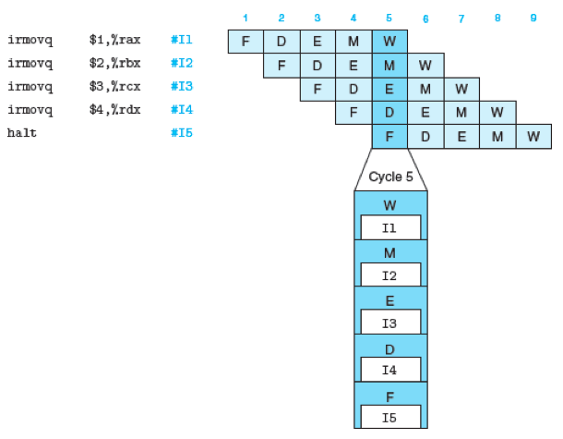
Pipeline Demonstration

Slide 54
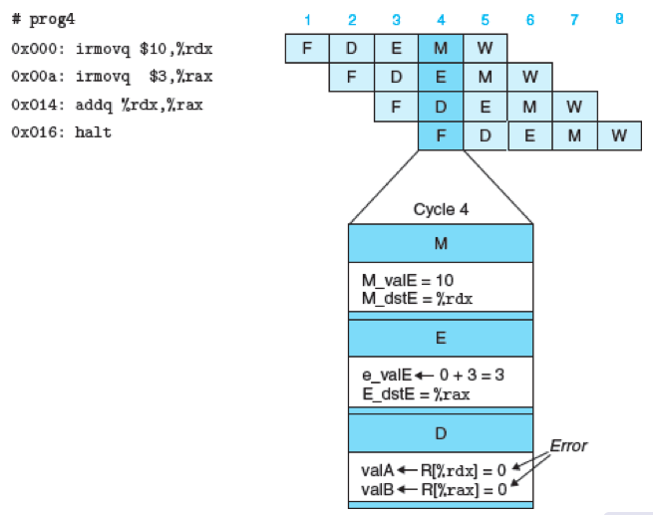
Data Dependencies: No Nop
Assume all registers initialized to zero

Slide 55
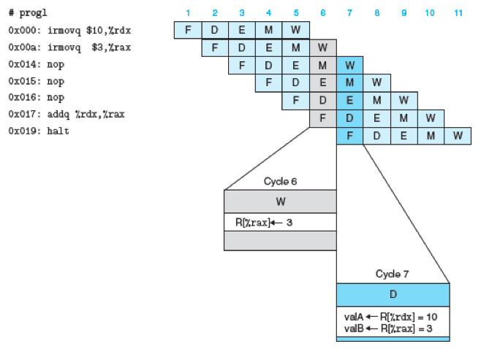
Data Dependencies: 3 Nop’s
Notes:
The CPU hardware can dynamically detect a data dependency, as in the add instruction here, and *stall* the forward progress of that instruction through the pipeline until the results are ready. In this case, the add would be stalled at the decode stage waiting until both %rdx and %rax were set properly/written back. This stalling effectively introduces nops into the pipeline without needing a compiler to do it.

Slide 56
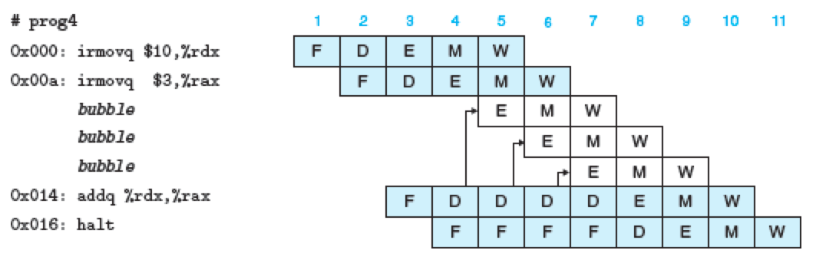
Stalling an Instruction
CPU hardware recognizes a data dependency/hazard and stalls an instruction until results are ready
In our example, addq instruction depends on %rdx and %rax
These are not set until the Writeback stages of each irmovq are done
So stall addq instruction at the Decode stage, introducing bubbles or effectively nops

Slide 57
Branch Misprediction Example
0x000: xorl %eax,%eax # %eax always zero
0x002: jne t # Not taken
0x007: irmovl $1, %eax # Fall through
0x00d: nop
0x00e: nop
0x00f: nop
0x010: halt
0x011: t: irmovl $3, %edx # Target (Should not execute)
0x017: irmovl $4, %ecx # Should not execute
0x01d: irmovl $5, %edx # Should not execute
Should only execute first 7 instructions

Slide 58
Branch Misprediction Trace
Incorrectly execute multiple instructions at branch target
CPU hardware realizes a mistake has occurred in branch prediction, and ignores the results of speculative execution, makes the correct jump and starts refilling the pipeline
Notes:
It’s not until the M stage that the M registers receives the condition codes from the E stage, and can feedback to the PC predictor that a branch has been mispredicted. See full PIPE diagram p. 440 Fig 4.52.

Slide 59
Return Example
0x000: irmovl Stack,%esp # Initialize stack pointer
0x006: nop # Avoid hazard on %esp
0x007: nop
0x008: nop
0x009: call p # Procedure call
0x00e: irmovl $5,%esi # Return point
0x014: halt
0x020: .pos 0x20
0x020: p: nop # procedure
0x021: nop
0x022: nop
0x023: ret
0x024: irmovl $1,%eax # Should not be executed
0x02a: irmovl $2,%ecx # Should not be executed
0x030: irmovl $3,%edx # Should not be executed
0x036: irmovl $4,%ebx # Should not be executed
0x100: .pos 0x100
0x100: Stack: # Stack: Stack pointer
Require lots of nops to avoid data hazards
Notes:
Note the 3 nops in p are to avoid a 2nd data hazard between call p and ret, namely call p will change the stack pointer, which takes time to flow through the pipeline until the Writeback stage. There are 3 nops because when the call p is at the Writeback stage, the ret can be at the Decode stage, which is a difference of 3 stages.

Slide 60
Incorrect Return Example
Incorrectly execute 3 instructions following ret

Slide 61
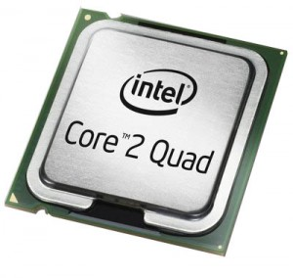
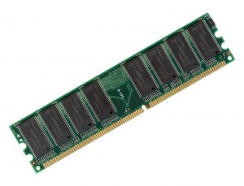
Chapter Mapping
Chapter 3
add a,b
sub a,b
Chapter 7
move a…
Lines of
Source
code
Pre-processor
&
Compiler
Lines of
Assembly
code
Assembler
&
Linker
Chapter 8
Chapter 2
Chapter 5
Operating
System
10101010
00001010
Chapter 9
01010111
10101010
Lines of
Binary
code &
data
Memory
11101110
Chapters 3, 4, 5 and 6
00111011
10000111

Slide 62
Supplementary Slides Chapter 4

Slide 63
Instruction Set Architecture
Assembly Language View
Processor state
Registers, memory, …
Instructions
addl, movl, leal, …
How instructions are encoded as bytes
Layer of Abstraction
Above: how to program machine
Processor executes instructions in a sequence
Below: what needs to be built
Use variety of tricks to make it run fast
E.g., execute multiple instructions simultaneously
Application
Program
Compiler
OS
ISA
CPU
Design
Circuit
Design
Chip
Layout

Slide 64
Building Blocks
fun
=
Combinational Logic
Compute Boolean functions of inputs
Continuously respond to input changes
Operate on data and implement control
A
A
L
U
B
MUX
0
1
Storage Elements
Store bits
Addressable memories
Non-addressable registers
Loaded only as clock rises
valA
Register
file
srcA
A
valW
W
dstW
valB
srcB
B
Clock
Clock

Slide 65
Move Instruction Examples (32-bit)
IA32
Y86
Encoding
movl $0xabcd, %edx
irmovl $0xabcd, %edx
30 82 cd ab 00 00
movl %esp, %ebx
rrmovl %esp, %ebx
20 43
movl -12(%ebp),%ecx
mrmovl -12(%ebp),%ecx
50 15 f4 ff ff ff
movl %esi,0x41c(%esp)
rmmovl %esi,0x41c(%esp)
40 64 1c 04 00 00
movl $0xabcd, (%eax)
—
movl %eax, 12(%eax,%edx)
—
movl (%ebp,%eax,4),%ecx
—

Slide 66
Y86 Code Generation Example (32-bit)
First Try
Write typical array code
Compile with gcc -O2 -S
Problem
Hard to do array indexing on Y86
Since don’t have scaled addressing modes
/* Find number of elements in
null-terminated list */
int len1(int a[])
{
int len;
for (len = 0; a[len]; len++)
;
return len;
}
L18:
incl %eax
cmpl $0,(%edx,%eax,4)
jne L18

Slide 67
Y86 Code Generation Example #2 (32-bit)
Second Try
Write with pointer code
Compile with gcc -O2 -S
Result
Don’t need to do indexed addressing
/* Find number of elements in
null-terminated list */
int len2(int a[])
{
int len = 0;
while (*a++)
len++;
return len;
}
L24:
movl (%edx),%eax
incl %ecx
L26:
addl $4,%edx
testl %eax,%eax
jne L24

Slide 68
Y86 Code Generation Example #3 (32-bit)
IA32 Code
Setup
Y86 Code
Setup
len2:
pushl %ebp
xorl %ecx,%ecx
movl %esp,%ebp
movl 8(%ebp),%edx
movl (%edx),%eax
jmp L26
len2:
pushl %ebp # Save %ebp
xorl %ecx,%ecx # len = 0
rrmovl %esp,%ebp # Set frame
mrmovl 8(%ebp),%edx # Get a
mrmovl (%edx),%eax # Get *a
jmp L26 # Goto entry
L24:
movl (%edx),%eax
incl %ecx
L26:
addl $4,%edx
testl %eax,%eax
jne L24

Slide 69
Y86 Code Generation Example #4 (32-bit)
IA32 Code
Loop + Finish
Y86 Code
Loop + Finish
L24:
movl (%edx),%eax
incl %ecx
L26:
addl $4,%edx
testl %eax,%eax
jne L24
movl %ebp,%esp
movl %ecx,%eax
popl %ebp
ret
L24:
mrmovl (%edx),%eax # Get *a
irmovl $1,%esi
addl %esi,%ecx # len++
L26: # Entry:
irmovl $4,%esi
addl %esi,%edx # a++
andl %eax,%eax # *a == 0?
jne L24 # No—Loop
rrmovl %ebp,%esp # Pop
rrmovl %ecx,%eax # Rtn len
popl %ebp
ret

Slide 70
Assembling Y86 Program
unix> yas eg.ys
Generates “object code” file eg.yo
Actually looks like disassembler output
0x000: 308400010000 | irmovl Stack,%esp # Set up stack
0x006: 2045 | rrmovl %esp,%ebp # Set up frame
0x008: 308218000000 | irmovl List,%edx
0x00e: a028 | pushl %edx # Push argument
0x010: 8028000000 | call len2 # Call Function
0x015: 10 | halt # Halt
0x018: | .align 4
0x018: | List: # List of elements
0x018: b3130000 | .long 5043
0x01c: ed170000 | .long 6125
0x020: e31c0000 | .long 7395
0x024: 00000000 | .long 0

Slide 71
Simulating Y86 Program
unix> yis eg.yo
Instruction set simulator
Computes effect of each instruction on processor state
Prints changes in state from original
Stopped in 41 steps at PC = 0x16. Exception 'HLT', CC Z=1 S=0 O=0
Changes to registers:
%eax: 0x00000000 0x00000003
%ecx: 0x00000000 0x00000003
%edx: 0x00000000 0x00000028
%esp: 0x00000000 0x000000fc
%ebp: 0x00000000 0x00000100
%esi: 0x00000000 0x00000004
Changes to memory:
0x00f4: 0x00000000 0x00000100
0x00f8: 0x00000000 0x00000015
0x00fc: 0x00000000 0x00000018

Slide 72
Y86 Program Structure
irmovl Stack,%esp # Set up stack
rrmovl %esp,%ebp # Set up frame
irmovl List,%edx
pushl %edx # Push argument
call len2 # Call Function
halt # Halt
.align 4
List: # List of elements
.long 5043
.long 6125
.long 7395
.long 0
# Function
len2:
. . .
# Allocate space for stack
.pos 0x100
Stack:
Program starts at address 0
Must set up stack
Make sure don’t overwrite code!
Must initialize data
Can use symbolic names

Slide 73
Y86 SEQ Hardware Structure
State
Program counter register (PC)
Condition code register (CC)
Register File
Memories
Access same memory space
Data: for reading/writing program data
Instruction: for reading instructions
Instruction Flow
Read instruction at address specified by PC
Process through stages
Update program counter

Slide 74
SEQ Stages
Fetch
Read instruction from instruction memory
Decode
Read program registers
Execute
Compute value or address
Memory
Read or write data
Write Back
Write program registers
PC
Update program counter

Slide 75
SEQ Hardware
Key
Blue boxes: predesigned hardware blocks
E.g., memories, ALU
Gray boxes: control logic
Describe in HCL
White ovals: labels for signals
Thick lines: 32-bit word values
Thin lines: 4-8 bit values
Dotted lines: 1-bit values

Slide 76
Hardware Control Language
Very simple hardware description language
Can only express limited aspects of hardware operation
Parts we want to explore and modify
Data Types
bool: Boolean
a, b, c, …
int: words
A, B, C, …
Does not specify word size---bytes, 32-bit words, …
Statements
bool a = bool-expr ;
int A = int-expr ;

Slide 77
HCL Operations
Classify by type of value returned
Boolean Expressions
Logic Operations
a && b, a || b, !a
Word Comparisons
A == B, A != B, A < B, A <= B, A >= B, A > B
Set Membership
A in { B, C, D }
Same as A == B || A == C || A == D
Word Expressions
Case expressions
[ a : A; b : B; c : C ]
Evaluate test expressions a, b, c, … in sequence
Return word expression A, B, C, … for first successful test

Slide 78
Executing call
call Dest
8
0
Dest
return:
XX
XX
target:
XX
XX
Fetch
Read 5 bytes
Increment PC by 5
Decode
Read stack pointer
Execute
Decrement stack pointer by 4
Memory
Write incremented PC to new value of stack pointer
Write back
Update stack pointer
PC Update
Set PC to Dest

Slide 79
Stage Computation: call
call Dest
Fetch
icode:ifun ← M₁[PC]
Read instruction byte
valC ← M₄[PC+1]
Read destination address
valP ← PC+5
Compute return point
Decode
valB ← R[%esp]
Read stack pointer
Execute
valE ← valB + –4
Decrement stack pointer
Memory
M₄[valE] ← valP
Write return value on stack
Write
back
R[%esp] ← valE
Update stack pointer
PC update
PC ← valC
Set PC to destination
Use ALU to decrement stack pointer
Store incremented PC

Slide 80
Executing ret
ret
9
0
return:
XX
XX
Fetch
Read 1 byte
Decode
Read stack pointer
Execute
Increment stack pointer by 4
Memory
Read return address from old stack pointer
Write back
Update stack pointer
PC Update
Set PC to return address

Slide 81
Stage Computation: ret
ret
Fetch
icode:ifun ← M₁[PC]
Read instruction byte
Decode
valA ← R[%esp]
Read operand stack pointer
valB ← R[%esp]
Read operand stack pointer
Execute
valE ← valB + 4
Increment stack pointer
Memory
valM ← M₄[valA]
Read return address
Write
back
R[%esp] ← valE
Update stack pointer
PC update
PC ← valM
Set PC to return address
Use ALU to increment stack pointer
Read return address from memory

Slide 82
Computation Steps
OPl rA, rB
Fetch
icode,ifun
icode:ifun ← M₁[PC]
Read instruction byte
rA,rB
rA:rB ← M₁[PC+1]
Read register byte
valC
[Read constant word]
valP
valP ← PC+2
Compute next PC
Decode
valA, srcA
valA ← R[rA]
Read operand A
valB, srcB
valB ← R[rB]
Read operand B
Execute
valE
valE ← valB OP valA
Perform ALU operation
Cond code
Set CC
Set condition code register
Memory
valM
[Memory read/write]
Write
back
dstE
R[rB] ← valE
Write back ALU result
dstM
[Write back memory result]
PC update
PC
PC ← valP
Update PC
All instructions follow same general pattern
Differ in what gets computed on each step

Slide 83
Computation Steps
call Dest
Fetch
icode,ifun
icode:ifun ← M₁[PC]
Read instruction byte
rA,rB
[Read register byte]
valC
valC ← M₄[PC+1]
Read constant word
valP
valP ← PC+5
Compute next PC
Decode
valA, srcA
[Read operand A]
valB, srcB
valB ← R[%esp]
Read operand B
Execute
valE
valE ← valB + –4
Perform ALU operation
Cond code
[Set condition code reg.]
Memory
valM
M₄[valE] ← valP
[Memory read/write]
Write
back
dstE
R[%esp] ← valE
[Write back ALU result]
dstM
Write back memory result
PC update
PC
PC ← valC
Update PC
All instructions follow same general pattern
Differ in what gets computed on each step

Slide 84
Computed Values
Fetch
icode Instruction code
ifun Instruction function
rA Instr. Register A
rB Instr. Register B
valC Instruction constant
valP Incremented PC
Decode
srcA Register ID A
srcB Register ID B
dstE Destination Register E
dstM Destination Register M
valA Register value A
valB Register value B
Execute
valE ALU result
Bch Branch flag
Memory
valM Value from memory

Slide 85
Fetch Logic
Predefined Blocks
PC: Register containing PC
Instruction memory: Read 6 bytes (PC to PC+5)
Split: Divide instruction byte into icode and ifun
Align: Get fields for rA, rB, and valC

Slide 86
Fetch Logic
Control Logic
Instr. Valid: Is this instruction valid?
Need regids: Does this instruction have a register bytes?
Need valC: Does this instruction have a constant word?

Slide 87
Fetch Control Logic
bool need_regids =
icode in { IRRMOVL, IOPL, IPUSHL, IPOPL,
IIRMOVL, IRMMOVL, IMRMOVL };
bool instr_valid = icode in
{ INOP, IHALT, IRRMOVL, IIRMOVL, IRMMOVL, IMRMOVL,
IOPL, IJXX, ICALL, IRET, IPUSHL, IPOPL };

Slide 88
Decode Logic
Register File
Read ports A, B
Write ports E, M
Addresses are register IDs or 8 (no access)
Control Logic
srcA, srcB: read port addresses
dstA, dstB: write port addresses

Slide 89
A Source
OPl rA, rB
Decode
valA ← R[rA]
Read operand A
rmmovl rA, D(rB)
Decode
valA ← R[rA]
Read operand A
popl rA
Decode
valA ← R[%esp]
Read stack pointer
jXX Dest
Decode
No operand
call Dest
Decode
No operand
ret
Decode
valA ← R[%esp]
Read stack pointer
int srcA = [
icode in { IRRMOVL, IRMMOVL, IOPL, IPUSHL } : rA;
icode in { IPOPL, IRET } : RESP;
1 : RNONE; # Don't need register
];

Slide 90
E Destination
OPl rA, rB
Write-back
R[rB] ← valE
Write back result
rmmovl rA, D(rB)
Write-back
None
popl rA
Write-back
R[%esp] ← valE
Update stack pointer
jXX Dest
Write-back
None
call Dest
Write-back
R[%esp] ← valE
Update stack pointer
ret
Write-back
R[%esp] ← valE
Update stack pointer
int dstE = [
icode in { IRRMOVL, IIRMOVL, IOPL} : rB;
icode in { IPUSHL, IPOPL, ICALL, IRET } : RESP;
1 : RNONE; # Don't need register
];

Slide 91
Execute Logic
Units
ALU
Implements 4 required functions
Generates condition code values
CC
Register with 3 condition code bits
bcond
Computes branch flag
Control Logic
Set CC: Should condition code register be loaded?
ALU A: Input A to ALU
ALU B: Input B to ALU
ALU fun: What function should ALU compute?

Slide 92
ALU A Input
OPl rA, rB
Execute
valE ← valB OP valA
Perform ALU operation
rmmovl rA, D(rB)
Execute
valE ← valB + valC
Compute effective address
popl rA
Execute
valE ← valB + 4
Increment stack pointer
jXX Dest
Execute
No operation
call Dest
Execute
valE ← valB + –4
Decrement stack pointer
ret
Execute
valE ← valB + 4
Increment stack pointer
int aluA = [
icode in { IRRMOVL, IOPL } : valA;
icode in { IIRMOVL, IRMMOVL, IMRMOVL } : valC;
icode in { ICALL, IPUSHL } : -4;
icode in { IRET, IPOPL } : 4;
# Other instructions don't need ALU
];

Slide 93
ALU Operation
OPl rA, rB
Execute
valE ← valB OP valA
Perform ALU operation
rmmovl rA, D(rB)
Execute
valE ← valB + valC
Compute effective address
popl rA
Execute
valE ← valB + 4
Increment stack pointer
jXX Dest
Execute
No operation
call Dest
Execute
valE ← valB + –4
Decrement stack pointer
ret
Execute
valE ← valB + 4
Increment stack pointer
int alufun = [
icode == IOPL : ifun;
1 : ALUADD;
];

Slide 94
Memory Logic
Memory
Reads or writes memory word
Control Logic
Mem. read: should word be read?
Mem. write: should word be written?
Mem. addr.: Select address
Mem. data.: Select data

Slide 95
Memory Address
OPl rA, rB
Memory
No operation
rmmovl rA, D(rB)
Memory
M₄[valE] ← valA
Write value to memory
popl rA
Memory
valM ← M₄[valA]
Read from stack
jXX Dest
Memory
No operation
call Dest
Memory
M₄[valE] ← valP
Write return value on stack
ret
Memory
valM ← M₄[valA]
Read return address
int mem_addr = [
icode in { IRMMOVL, IPUSHL, ICALL, IMRMOVL } : valE;
icode in { IPOPL, IRET } : valA;
# Other instructions don't need address
];

Slide 96
Memory Read
OPl rA, rB
Memory
No operation
rmmovl rA, D(rB)
Memory
M₄[valE] ← valA
Write value to memory
popl rA
Memory
valM ← M₄[valA]
Read from stack
jXX Dest
Memory
No operation
call Dest
Memory
M₄[valE] ← valP
Write return value on stack
ret
Memory
valM ← M₄[valA]
Read return address
bool mem_read = icode in { IMRMOVL, IPOPL, IRET };

Slide 97
PC Update Logic
New PC
Select next value of PC

Slide 98
PC Update
OPl rA, rB
PC update
PC ← valP
Update PC
rmmovl rA, D(rB)
PC update
PC ← valP
Update PC
popl rA
PC update
PC ← valP
Update PC
jXX Dest
PC update
PC ← Bch ? valC : valP
Update PC
call Dest
PC update
PC ← valC
Set PC to destination
ret
PC update
PC ← valM
Set PC to return address
int new_pc = [
icode == ICALL : valC;
icode == IJXX && Bch : valC;
icode == IRET : valM;
1 : valP;
];

Slide 99
SEQ Operation
State
PC register
Cond. Code register
Data memory
Register file
All updated as clock rises
Combinational Logic
ALU
Control logic
Memory reads
Instruction memory
Register file
Data memory

Slide 100
SEQ Operation #2
state set according to second irmovl instruction
combinational logic starting to react to state changes

Slide 101
SEQ Operation #3
state set according to second irmovl instruction
combinational logic generates results for addl instruction

Slide 102
SEQ Operation #4
state set according to addl instruction
combinational logic starting to react to state changes

Slide 103
SEQ Operation #5
state set according to addl instruction
combinational logic generates results for je instruction

Slide 104
SEQ Summary
Implementation
Express every instruction as series of simple steps
Follow same general flow for each instruction type
Assemble registers, memories, predesigned combinational blocks
Connect with control logic
Limitations
Too slow to be practical
In one cycle, must propagate through instruction memory, register file, ALU, and data memory
Would need to run clock very slowly
Hardware units only active for fraction of clock cycle

Slide 105
SEQ+ Hardware
Still sequential implementation
Reorder PC stage to put at beginning
PC Stage
Task is to select PC for current instruction
Based on results computed by previous instruction
Processor State
PC is no longer stored in register
But, can determine PC based on other stored information

Slide 106
Adding Pipeline Registers
W
M
E
D
F

Slide 107
Pipeline Stages
Fetch
Select current PC
Read instruction
Compute incremented PC
Decode
Read program registers
Execute
Operate ALU
Memory
Read or write data memory
Write Back
Update register file

Slide 108
PIPE- Hardware
Pipeline registers hold intermediate values from instruction execution
Forward (Upward) Paths
Values passed from one stage to next
Cannot jump past stages
e.g., valC passes through decode

Slide 109
Feedback Paths
Predicted PC
Guess value of next PC
Branch information
Jump taken/not-taken
Fall-through or target address
Return point
Read from memory
Register updates
To register file write ports

Slide 110
Data Dependencies: 1 Nop
# demo-h1.ys
1
2
3
4
5
6
7
8
9
0x000:
irmovl
$10,%
edx
F
D
E
M
W
0x006:
irmovl
$3,%
eax
F
D
E
M
W
F
F
D
D
E
E
M
M
W
0x00c:
nop
W
F
F
D
D
E
E
M
M
W
0x00d:
addl
%
edx
,%
eax
W
F
F
D
D
E
E
M
M
W
0x00f: halt
W
Cycle 5
W
W
f
R[
f
R[
]
]
10
%
10
%
edx
edx
M
M_
valE
= 3
M_
dstE
=
%
eax
•
•
•
D
D
Error
f
valA
f
valA
R[
R[
]
]
=
=
0
%
0
%
edx
edx
f
valB
f
valB
R[
R[
]
]
=
=
0
%
0
%
eax
eax

Slide 111
Data Dependencies: 2 Nop’s
# demo-h2.ys
1
2
3
4
5
6
7
8
9
10
F
F
D
D
E
E
M
M
W
0x000:
irmovl
$10,%
edx
W
F
F
D
D
E
E
M
M
W
0x006:
irmovl
$3,%
eax
W
F
F
D
D
E
E
M
M
W
0x00c:
nop
W
F
F
D
D
E
E
M
M
W
0x00d:
nop
W
F
F
D
D
E
E
M
M
W
0x00e:
addl
%
edx
,%
eax
W
F
F
D
D
E
E
M
M
W
0x010: halt
W
Cycle 6
W
W
W
f
f
R[
f
R[
R[
]
]
]
3
3
%
3
%
%
eax
eax
eax
•
•
•
•
•
•
D
D
D
f
f
valA
f
valA
valA
R[
R[
R[
]
]
]
=
=
=
10
10
%
10
Error
%
%
edx
edx
edx
f
f
valB
f
valB
valB
R[
R[
R[
]
]
]
=
=
=
0
0
%
0
%
%
eax
eax
eax

Slide 112
Pipeline Summary
Concept
Break instruction execution into 5 stages
Run instructions through in pipelined mode
Limitations
Can’t handle dependencies between instructions when instructions follow too closely
Data dependencies
One instruction writes register, later one reads it
Control dependency
Instruction sets PC in way that pipeline did not predict correctly
Mispredicted branch and return
Fixing the Pipeline – see text
Stalling – CPU sees dependencies & dynamically inserts nops
Forwarding data directly to next stage(s) rather than wait for the clock

Slide 113
Pipeline Summary
More modern CPUs use out-of-order execution and parallel execution to achieve faster performance
Pipelining is still popular in embedded processors

